Slide 1
Knowledge Graph
蘇建文

Slide 2
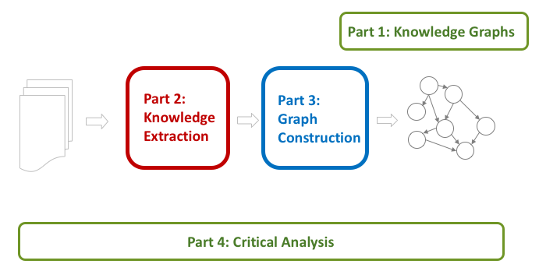
CONTENTS

Slide 3
What is
Knowledge
Graph?
PART
01

Slide 4
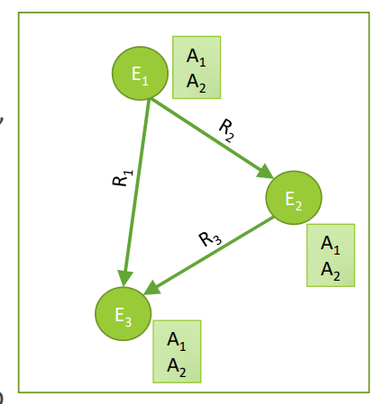
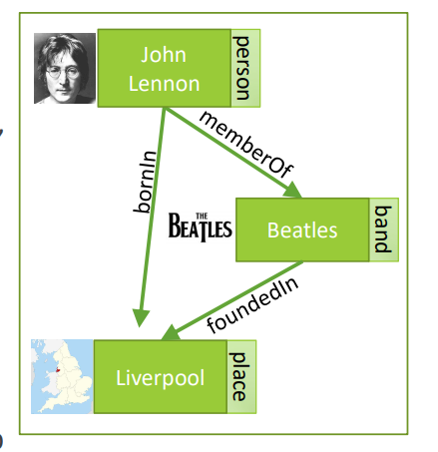
Knowledge Graph
Nodes are entities
Nodes are labeled with attributes
Edges between two nodes capture a relationship between entities

Slide 5
Why Knowledge Graph?
Humans:
Combat information overload
Explore via intuitive structure
Tool for supporting knowledge-driven tasks
AIs:
Key ingredient for many AI tasks
Bridge from data to human semantics
Use decades of work on graph analysis

Slide 6
Sources of Knowledge Graph
Structured Text:
Wikipedia Infoboxes, tables, databases, social nets
Unstructured Text
WWW, news, social media, reference articles
Images
Video
YouTube, video feeds

Slide 7
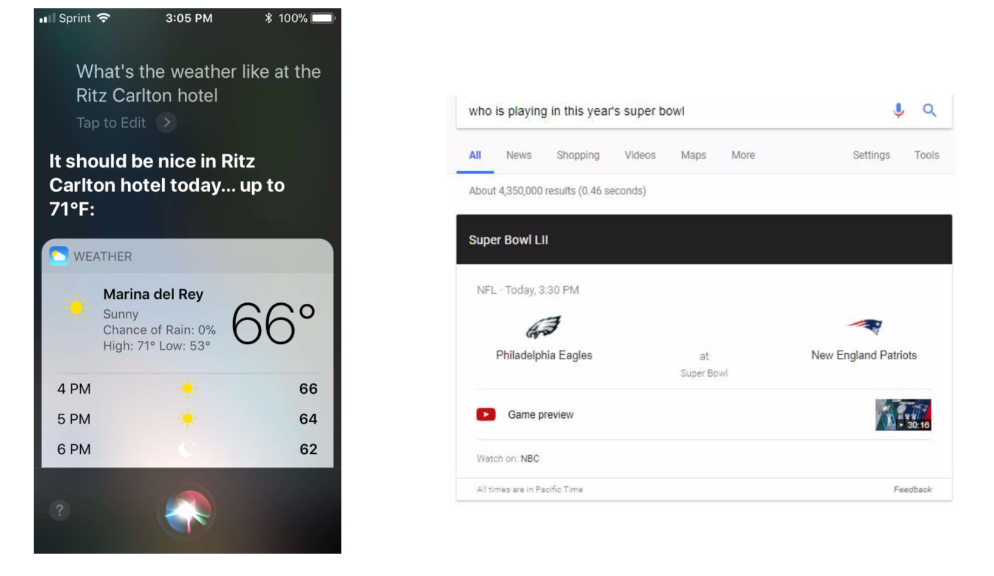
Application 1 QA
Notes:
語音助手 ＆ 搜尋引擎

Slide 8
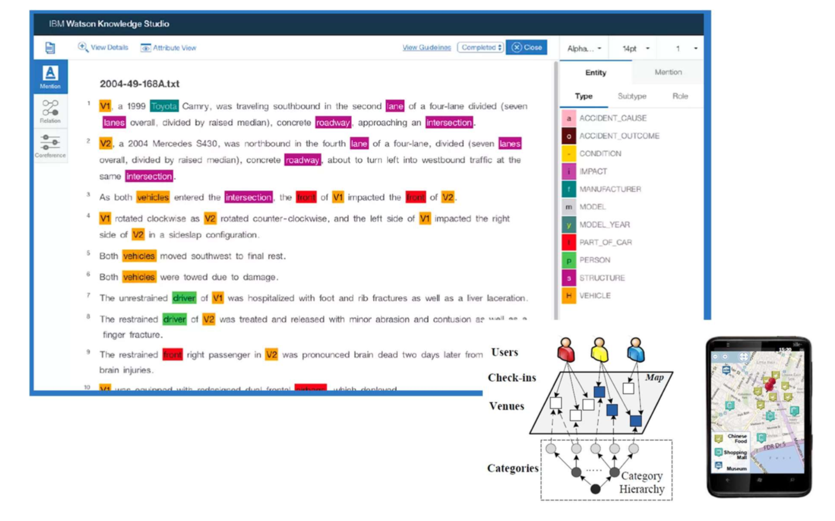
Application 2 Decision Support

Slide 9
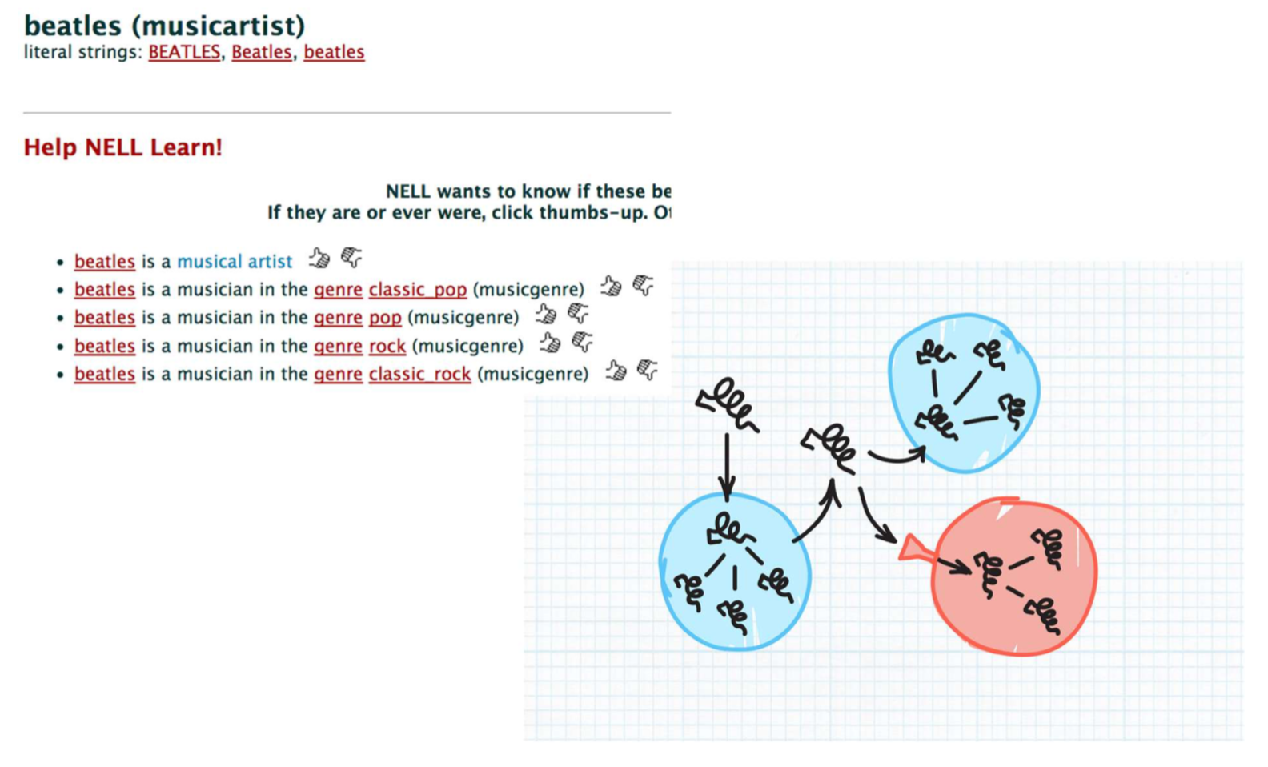
Application 3 Fueling Discovery
Notes:
將多句有關聯的句子轉成graph

Slide 10
Industry
Google Knowledge Graph
Amazon Product Graph
Facebook Graph API
IBM Watson
Microsoft Satori
LinkedIn Knowledge Graph
Yandex Object Answer

Slide 11
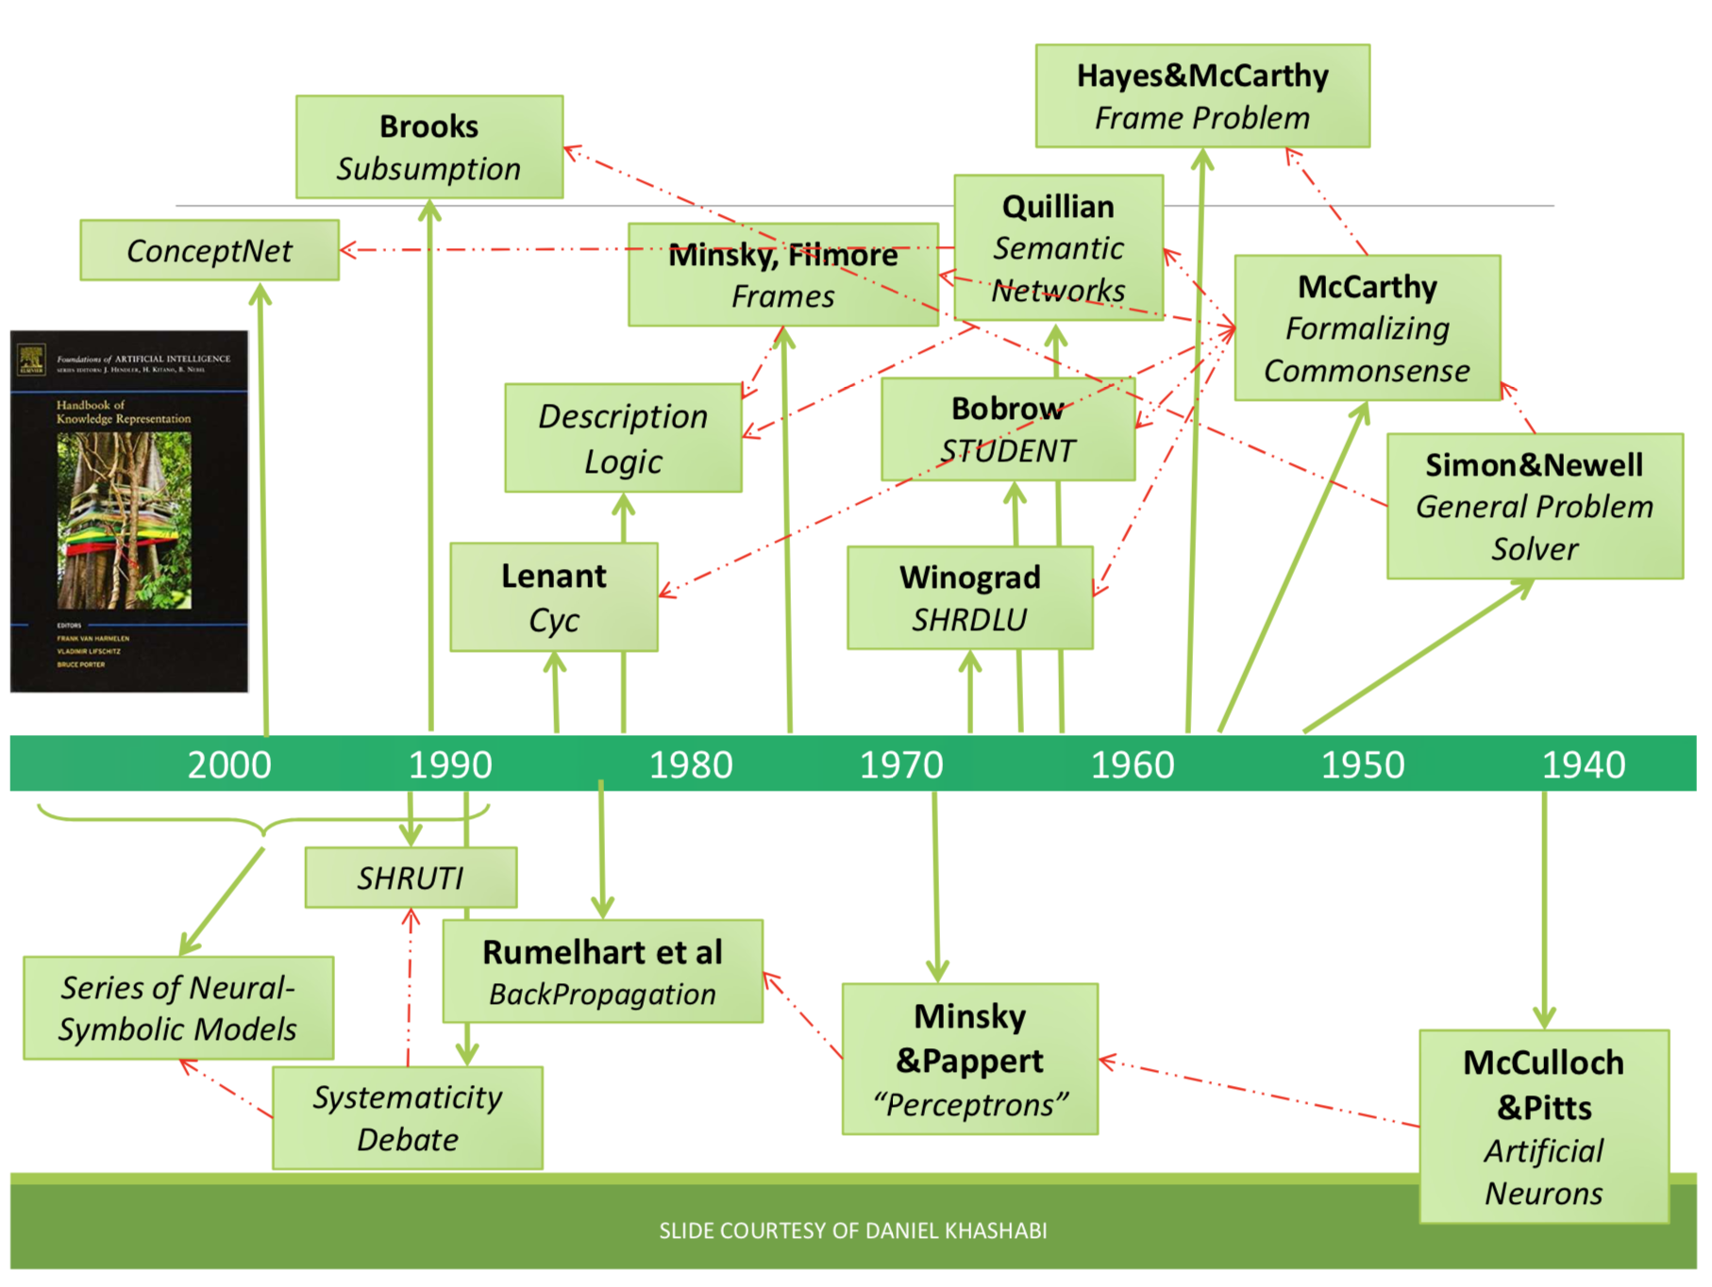
https://www.jiqizhixin.com/articles/2017-11-03-24
History
Notes:
從人工智慧分支出的專家系統
Sematic network -> ConceptNet
Semantic network:語義網直接向機器提供可直接用於程序處理的知識表示
Cyc:收集生活中常識知識並將其編碼集成到一個全面的本體知識庫, 而且提供了非常多的推理引擎，支持演繹推理和歸納推理
conceptNet: a freely-available semantic network, designed to help computers understand the meanings of words that people use.
---
neuron -> perceptron -> backprop

Slide 12
Knowledge Representation
RDF triples
ABox (assertions) versus TBox (terminology)
Semantic Web
Information Extraction from Text
Notes:
接下來會提到幾種表示knowledge的方式

Slide 13
RDF triples
Linked data透過三元組（Triple）之結構，以主詞（Subject）─ 述詞（Predicate）─ 受詞（Object）構成之Statement描述資訊實體
Notes:
http://ifii-enews.blogspot.com/2014/06/linked-datalink.html

Slide 14
ABox vs TBox
TBox定義了特定知識領域
ABox包含了TBox中概念的實例

Slide 15
Semantic Web
Standards for defining and exchanging knowledge
RDF, RDFa, JSON-LD, schema.org
RDFS, OWL, SKOS, FOAF
Annotated data provide critical resource for automation
Major weakness: annotate everything?
Notes:
RDFa: HTML5支援
JSON-LD: 結構化標記
https://www.slideshare.net/bobo52310/json-ldby-bobo

Slide 16
RDFS
RDFS在RDF的基礎上定義了一些固定的關鍵詞如：Class，subClassOf，type， Property， subPropertyOf， Domain， Range以及多了Schema層
Notes:
http://pelhans.com/2018/03/15/xiaoxiangkg-note1/#%E7%9F%A5%E8%AF%86%E5%9B%BE%E8%B0%B1%E6%8A%80%E6%9C%AF%E6%A6%82%E8%A7%88

Slide 17
Information Extraction from Text
Many challenges:
chunking
polysemy/word sense disambiguation
entity coreference
relational extraction
Notes:
處理斷句(透過詞性標註) word < chunk < sentence
一詞多義
詞對比到真實世界的entity
取得relation

Slide 18
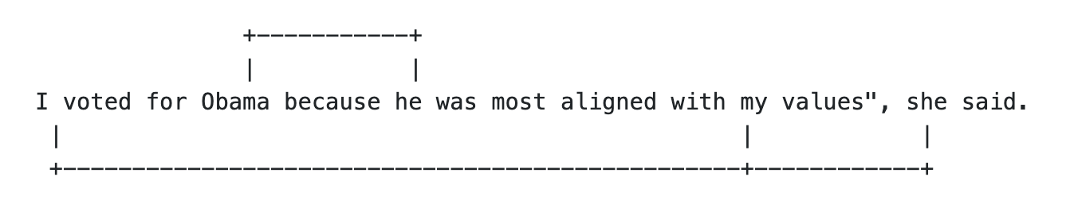
Entity Coreference Resolution
The task involves determining which entity mentions in a text or dialogue refer to the same real-world entity.
https://pdfs.semanticscholar.org/1fa9/c6f27335c377bded31ca8f7c1e39e25374ad.pdf

Slide 19
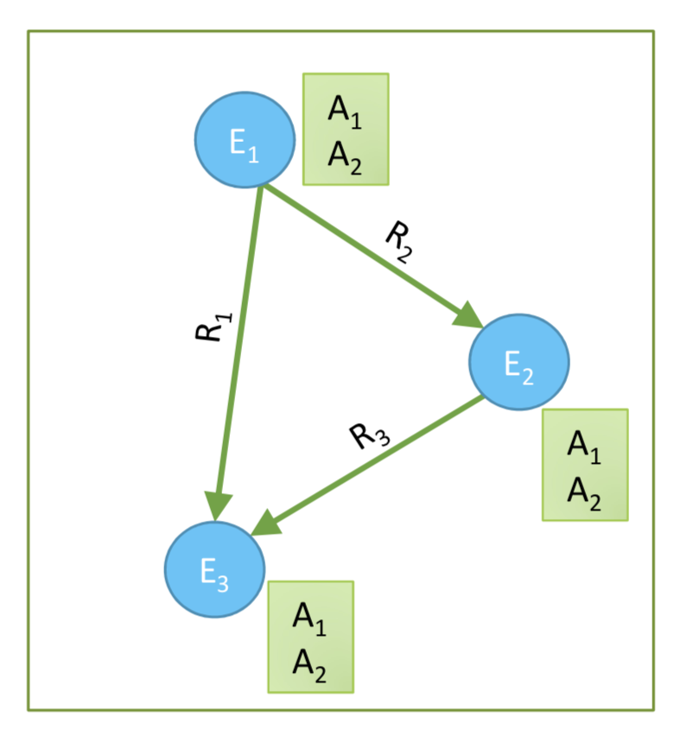
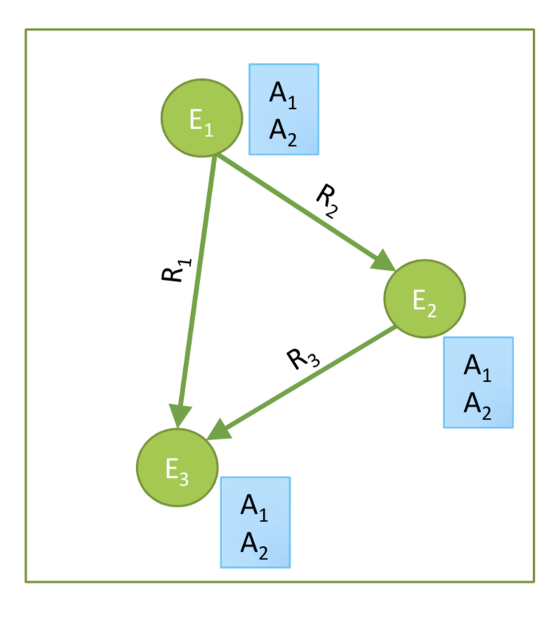
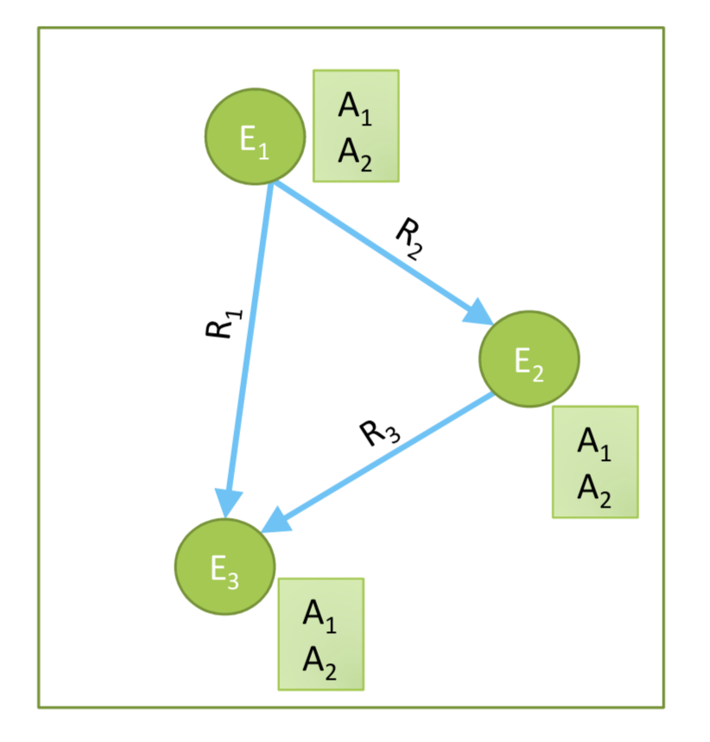
Basic problems
Who are the entities (nodes) in the graph?
What are their attributes and types (labels)?
How are they related (edges)?

Slide 20
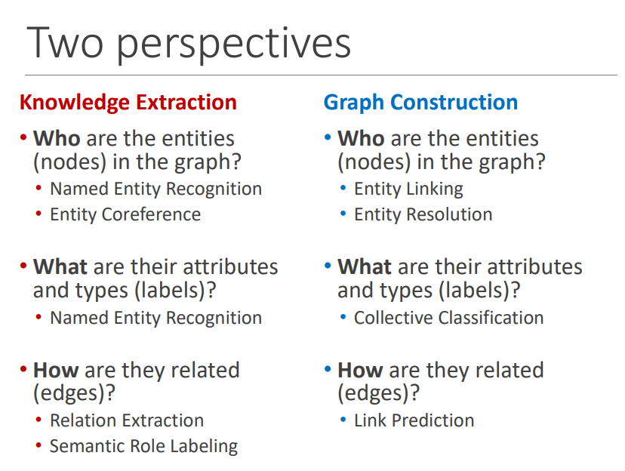
Knowledge Graph Construction

Slide 21
PART
02
Knowledge
Extraction

Slide 22
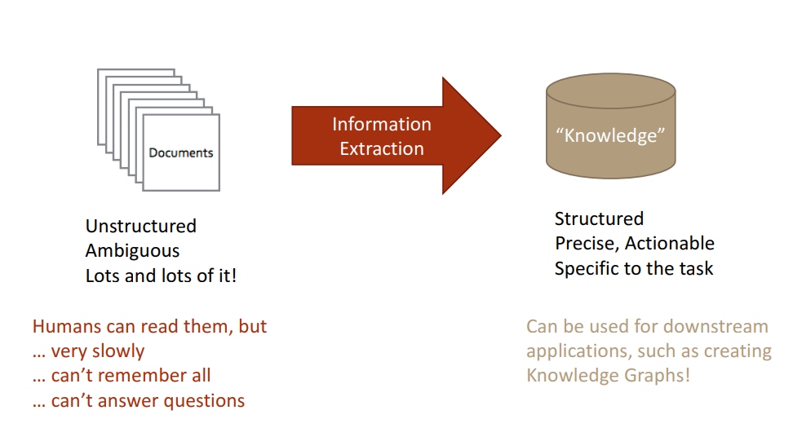
What is NLP?
Notes:
將文件整理成有結構的「知識」

Slide 23
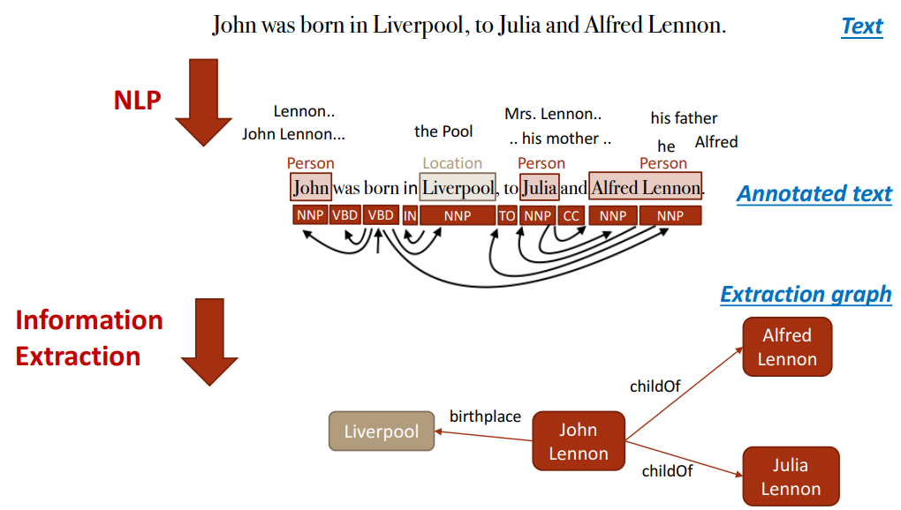
Knowledge Extraction
Notes:
將一串句子以NLP做tagging
透過 IE 建 graph

Slide 24
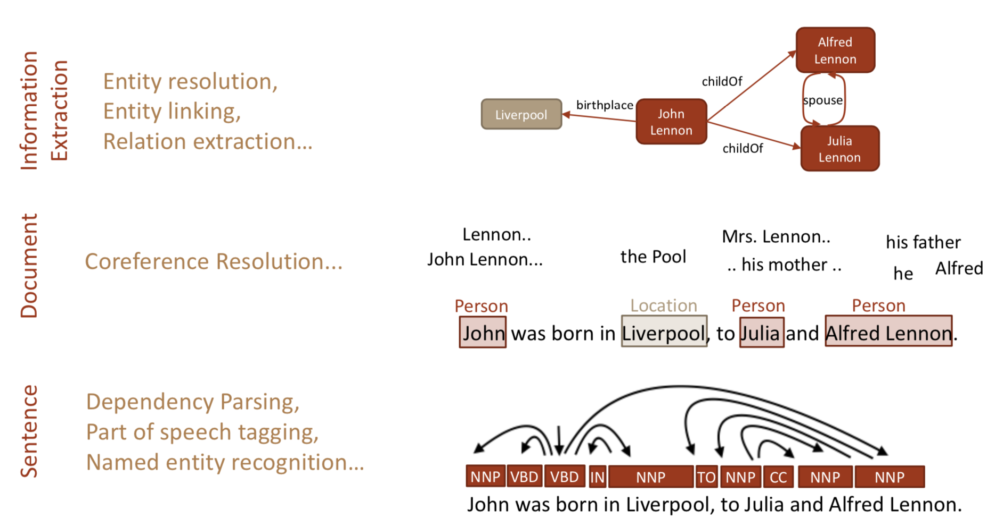
Breaking it Down
Notes:
以上是接下來會提到的方法

Slide 25
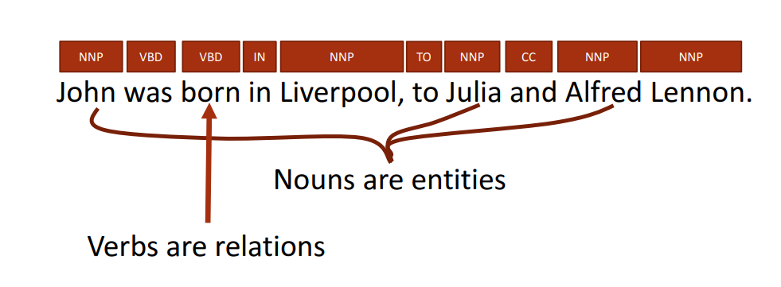
Tagging
Common approaches include CRFs, CNNs, LSTMs
Notes:
Noun => entities
Verb => relations

Slide 26
CRFs
Conditional random field
應用於標籤 — 樣本特徵對應問題
計算的是「條件概率」
在分詞 & 命名實體識別表現出色
Notes:
https://blog.csdn.net/aws3217150/article/details/68935789
https://towardsdatascience.com/conditional-random-field-tutorial-in-pytorch-ca0d04499463
A Conditional Random Field (CRF) is a standard model for predicting the most likely sequence of labels that correspond to a sequence of inputs.

Slide 27
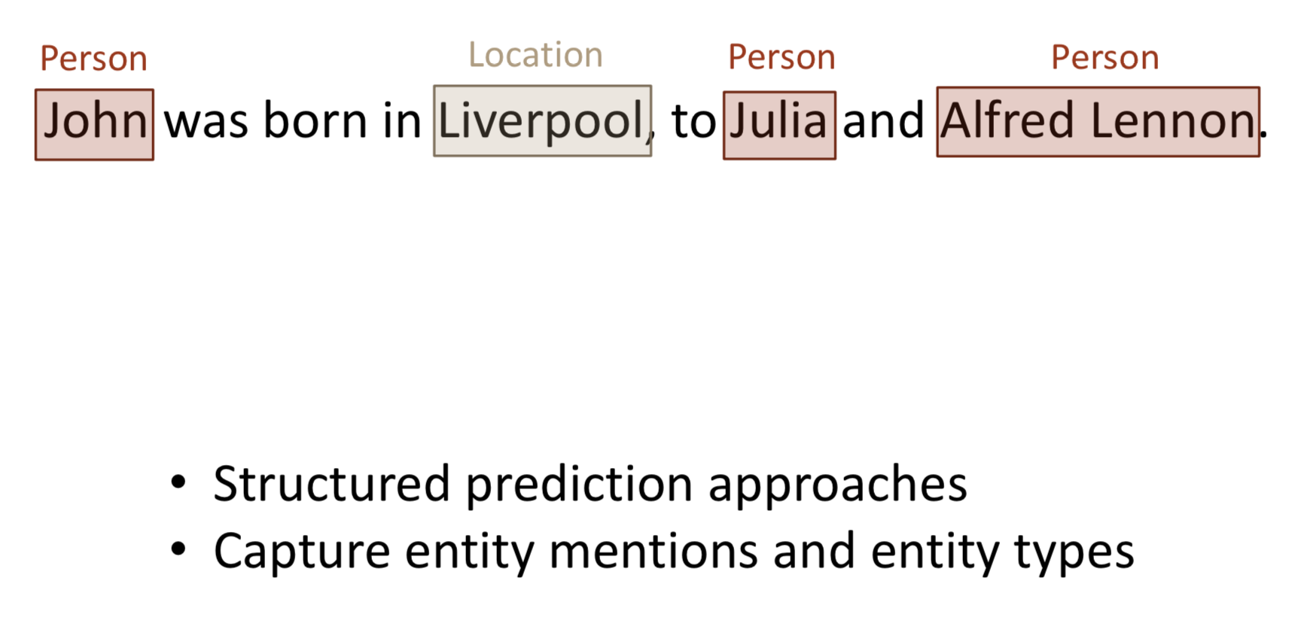
Detecting Named Entities
Notes:
命名實體識別技術(Named Entity Recognition)顧名思義就是讓電腦可以「辨識」出實體。
先將一個句子分詞以及做詞性標注,然後根據已有的實體資料庫來做判讀。

Slide 28
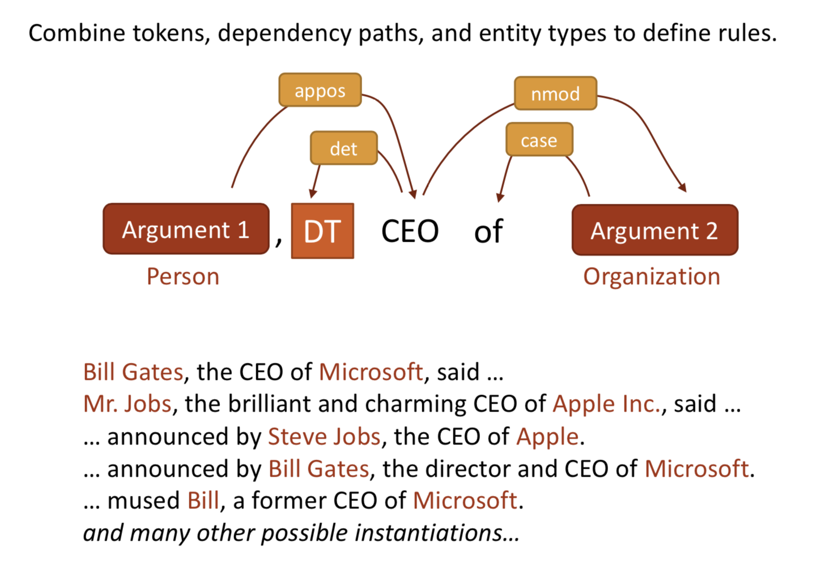
NLP annotations -> features for IE
Notes:
這裡假設要找 person, organization
det: determiner => the

Slide 29
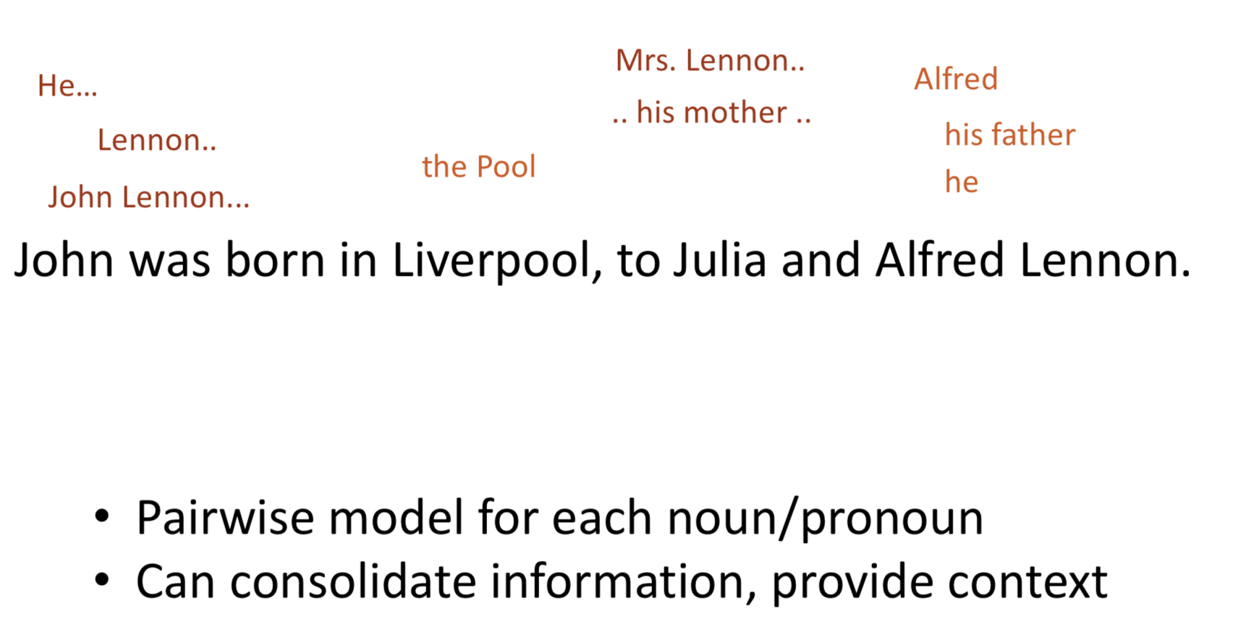
Within-document Coreference
Notes:
用同一段文章的 N 跟 proNoun來訓練pairwise model

Slide 30
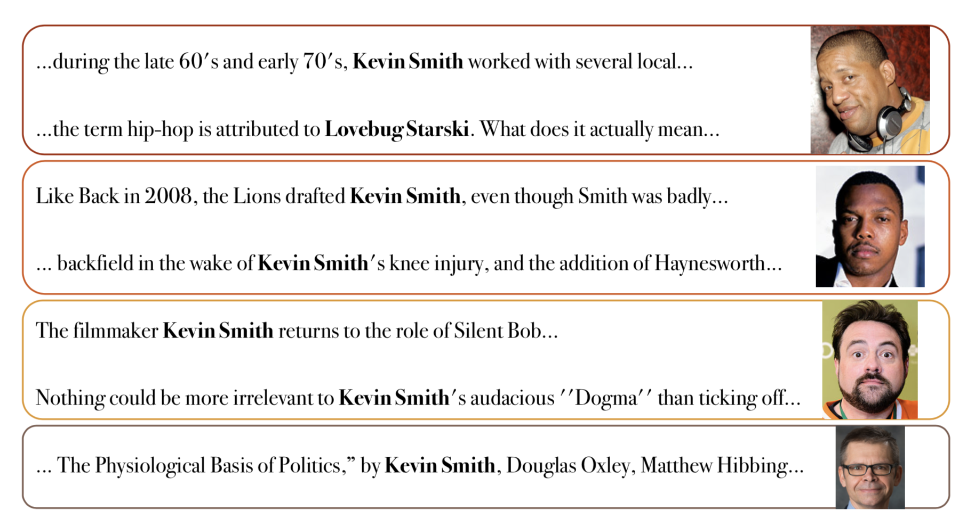
Entity Resolution & Linking
Notes:
Entity Resolution: 同個名字指的是不同的人
Linking : 同一個人有不同的名字，ex: linking

Slide 31
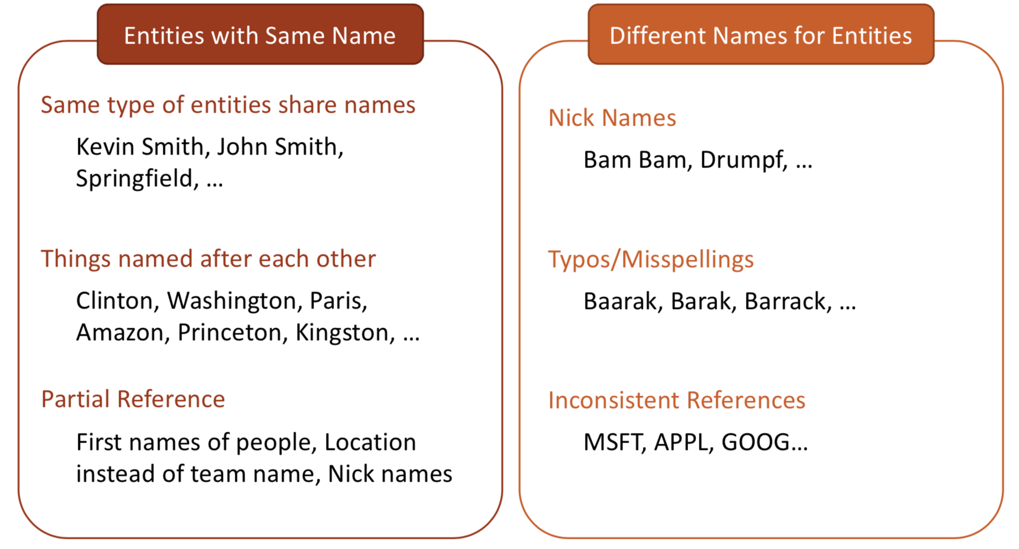
Entity Names: Two Main Problems
Notes:
不同實體有同樣名稱
同個名字多個人
小孩的姓氏一樣
只給部分資訊
同個實體也不同名稱
綽號
打錯字
縮寫

Slide 32
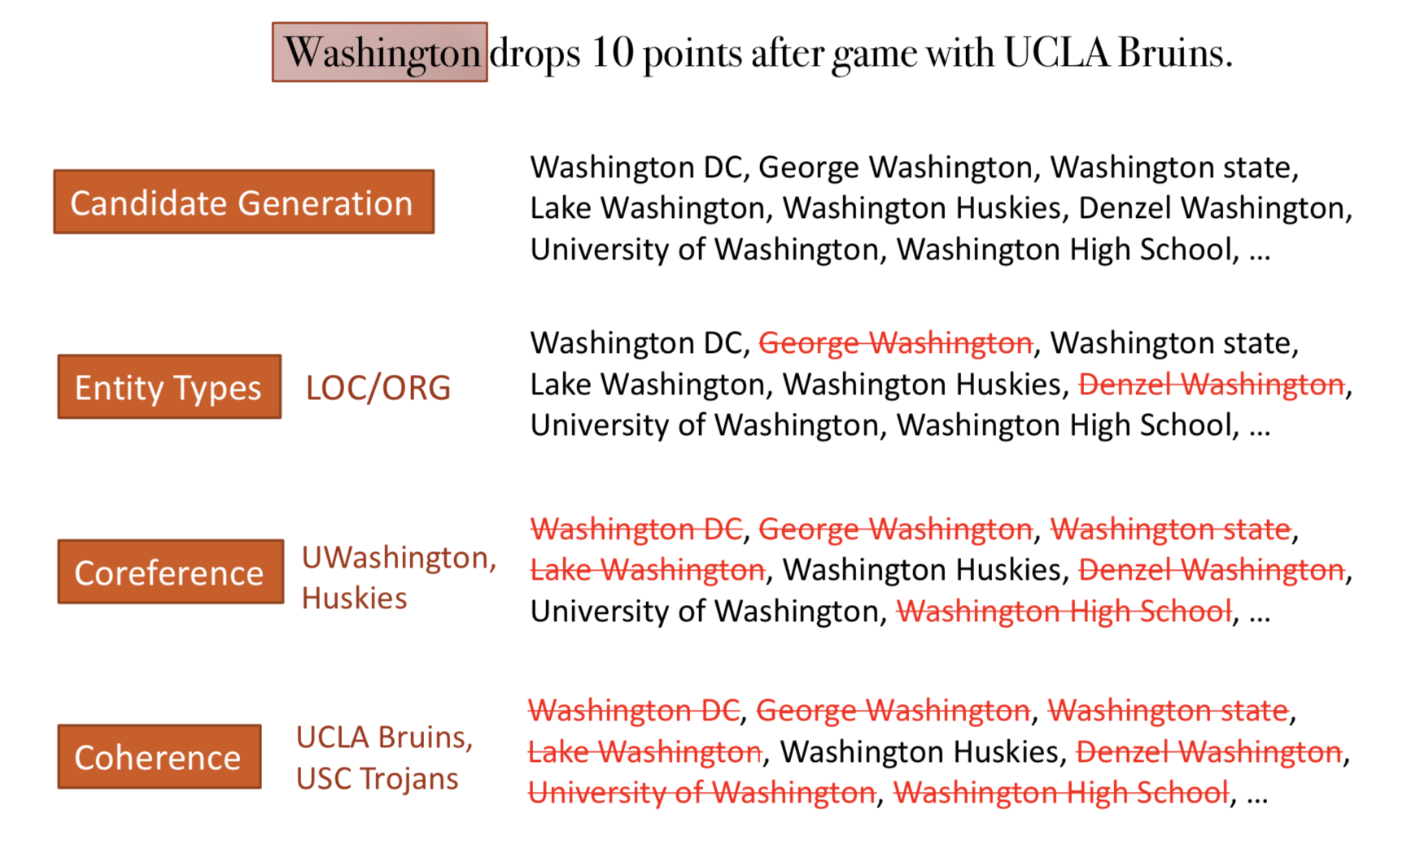
Entity Linking Approach
Notes:
先列出Washington的候選人
辨識entity的type
Coreference (處理代名詞)
Coherence 相關程度

Slide 33
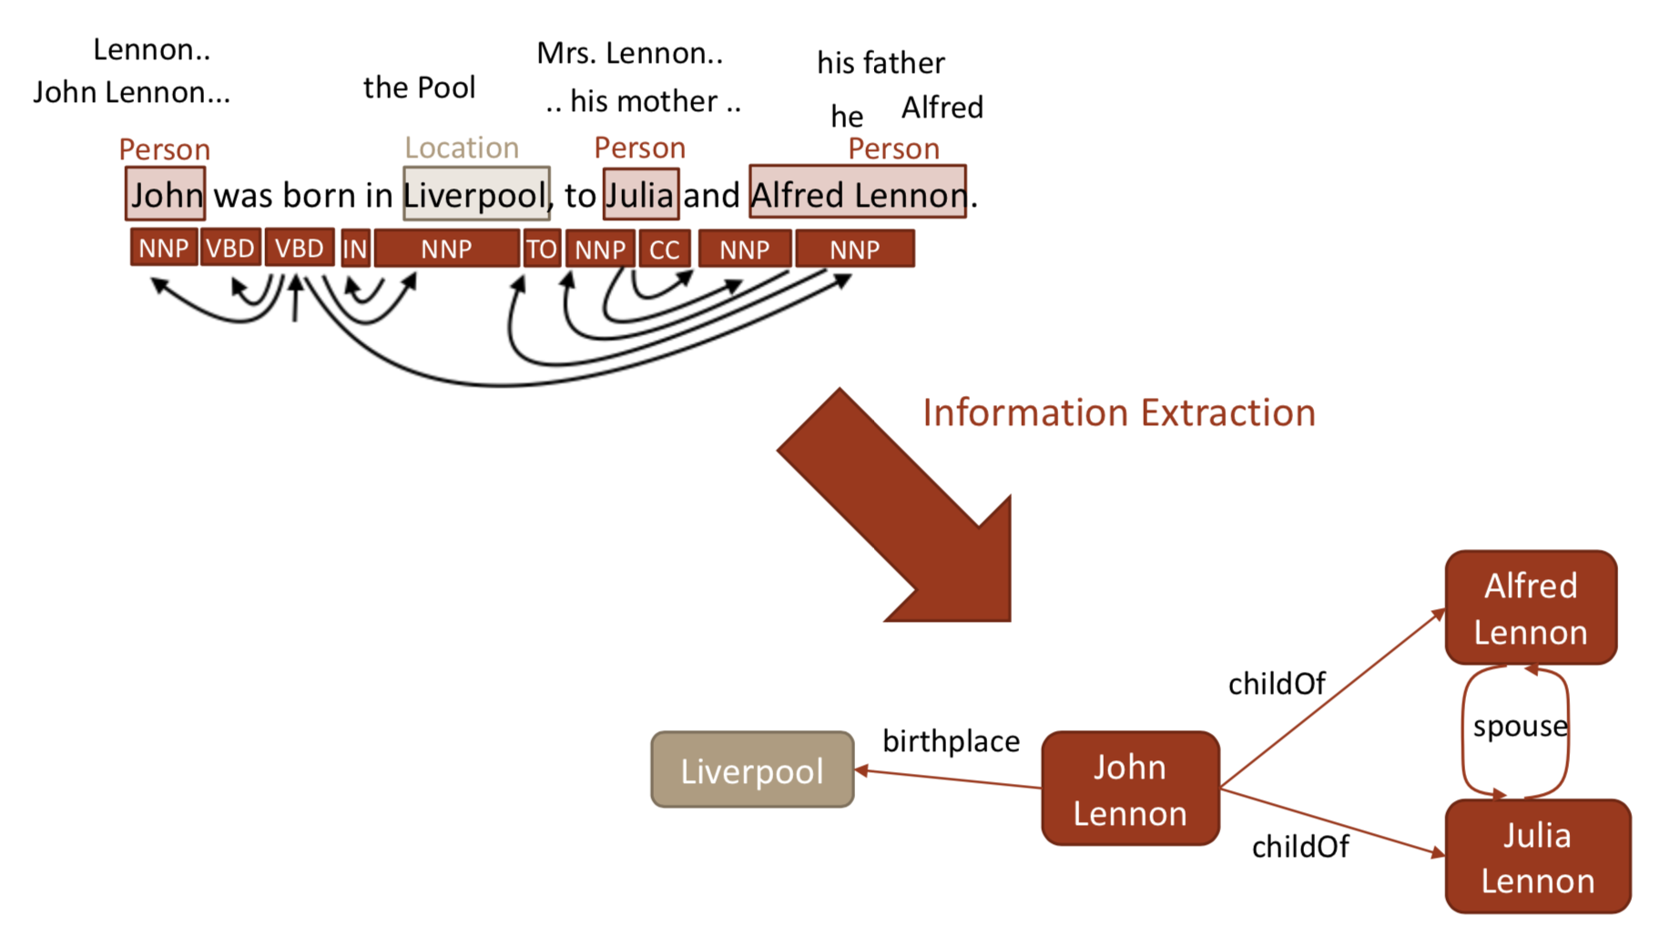
Information Extraction
Notes:
接下來會提一些提取info的方式

Slide 34
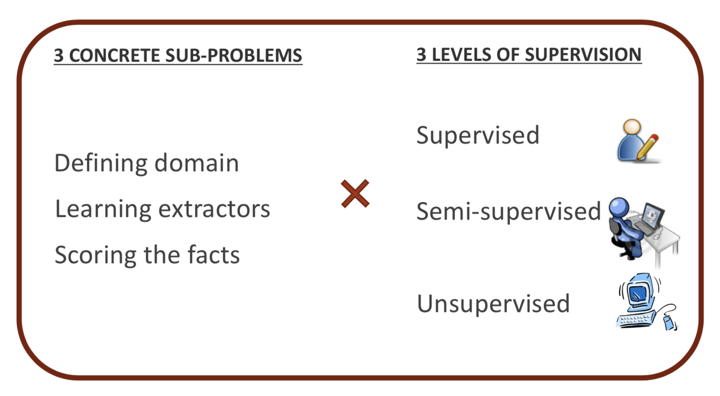
Information Extraction
Notes:
IE需要的步驟 ＆ 使用方法
Define domain
Learn extractor
Score 剛剛的extractor

Slide 35
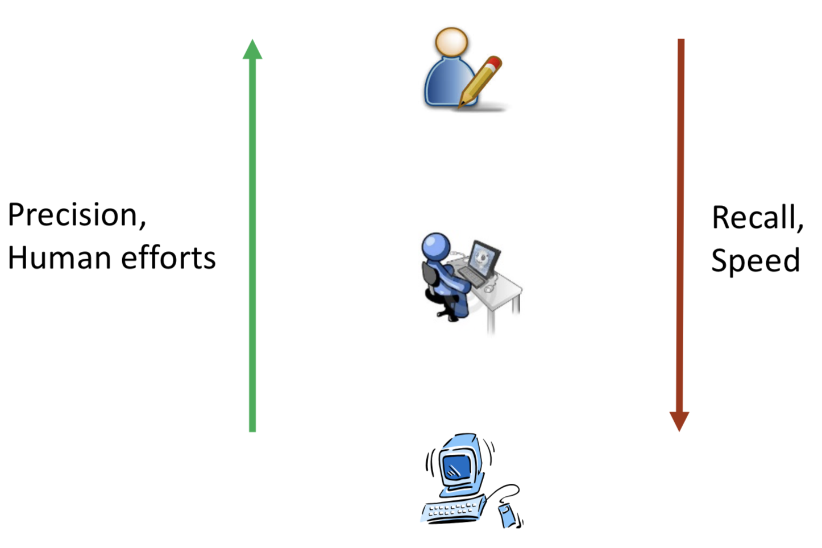
Effect of supervision on extractions
Notes:
使用人力比較準確但耗費資源
使用電腦速度快但是會犧牲一些準確度

Slide 36
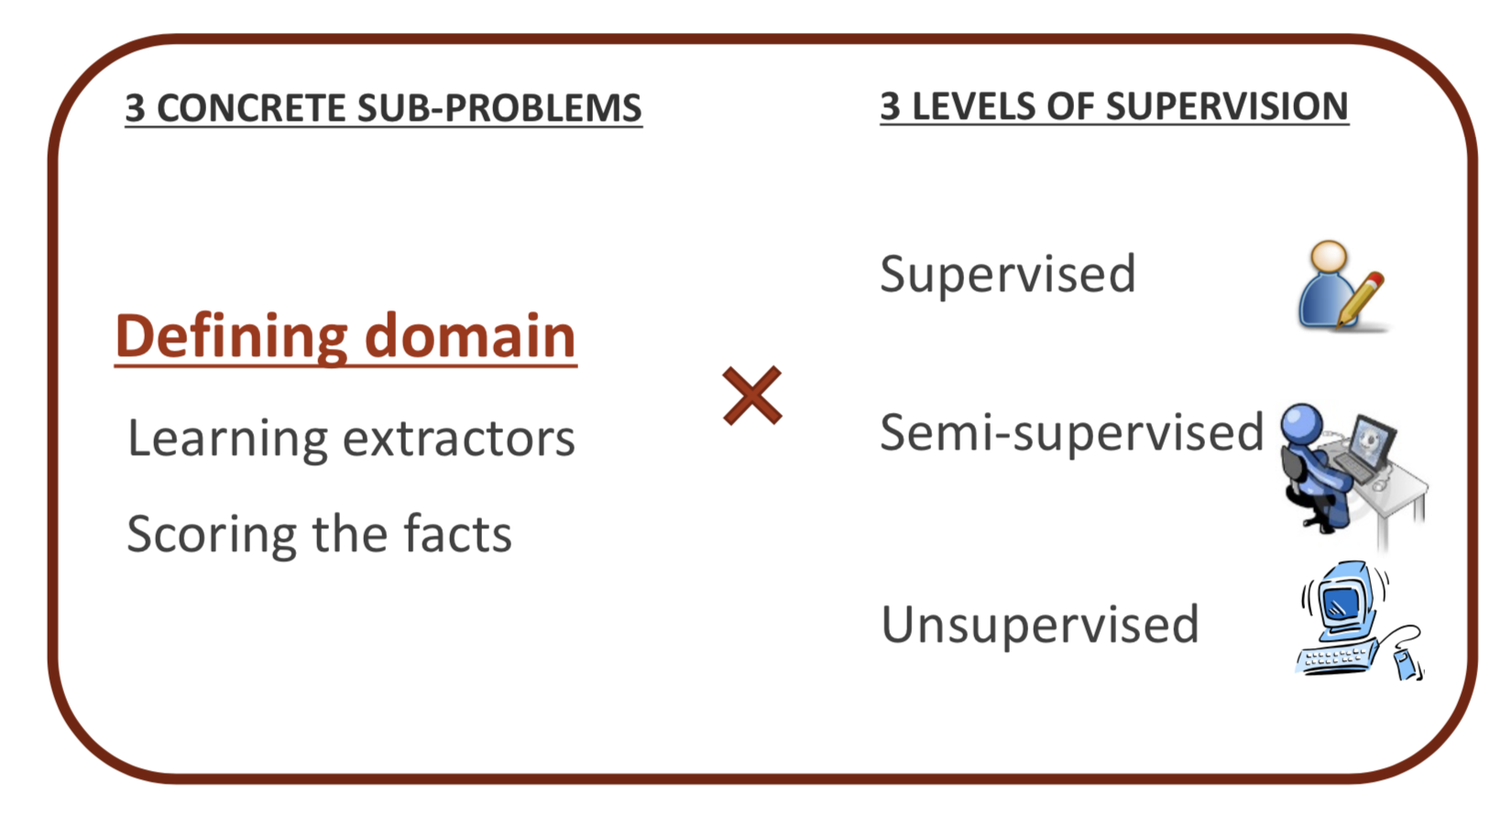
Defining domain

Slide 37
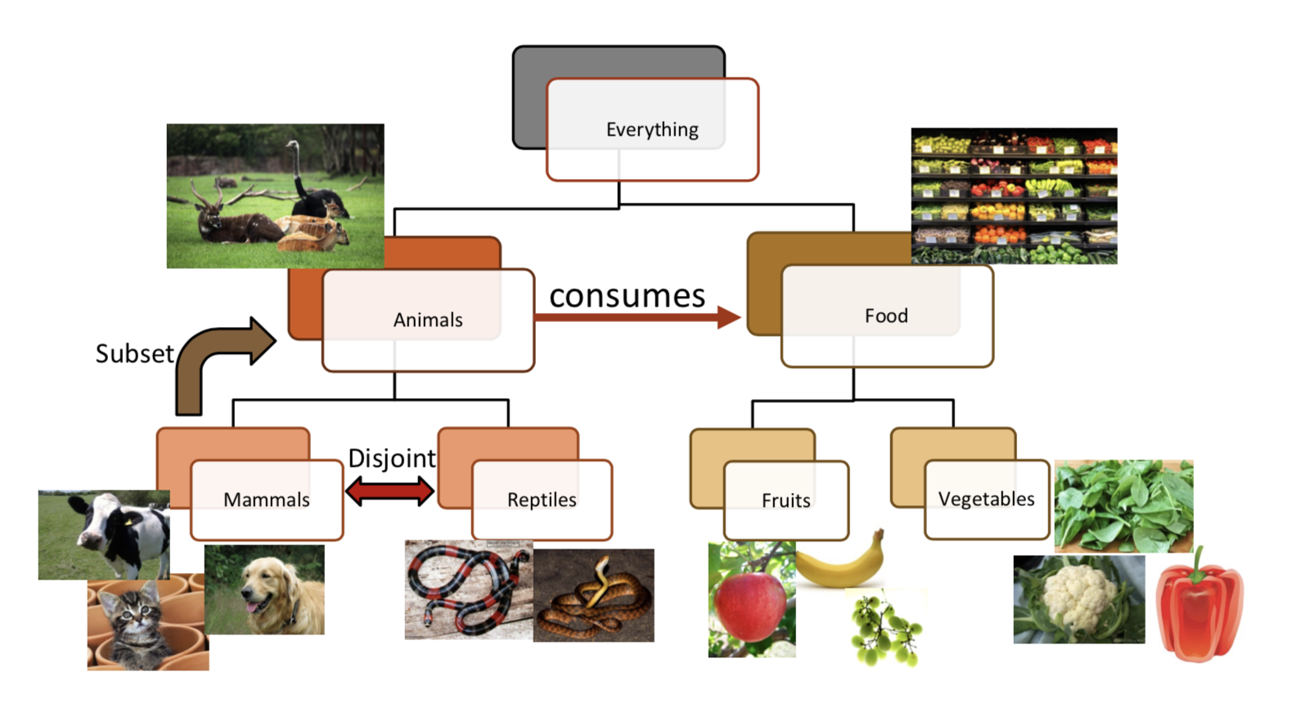
Defining Domain: Manual
Never-Ending Language Learner (NELL)
Notes:
http://www.cs.cmu.edu/~acarlson/papers/carlson-aaai10.pdf
NELL任務是學習如何閱讀網頁以獲取知識
https://www.jiqizhixin.com/articles/2017-11-03-24

Slide 38
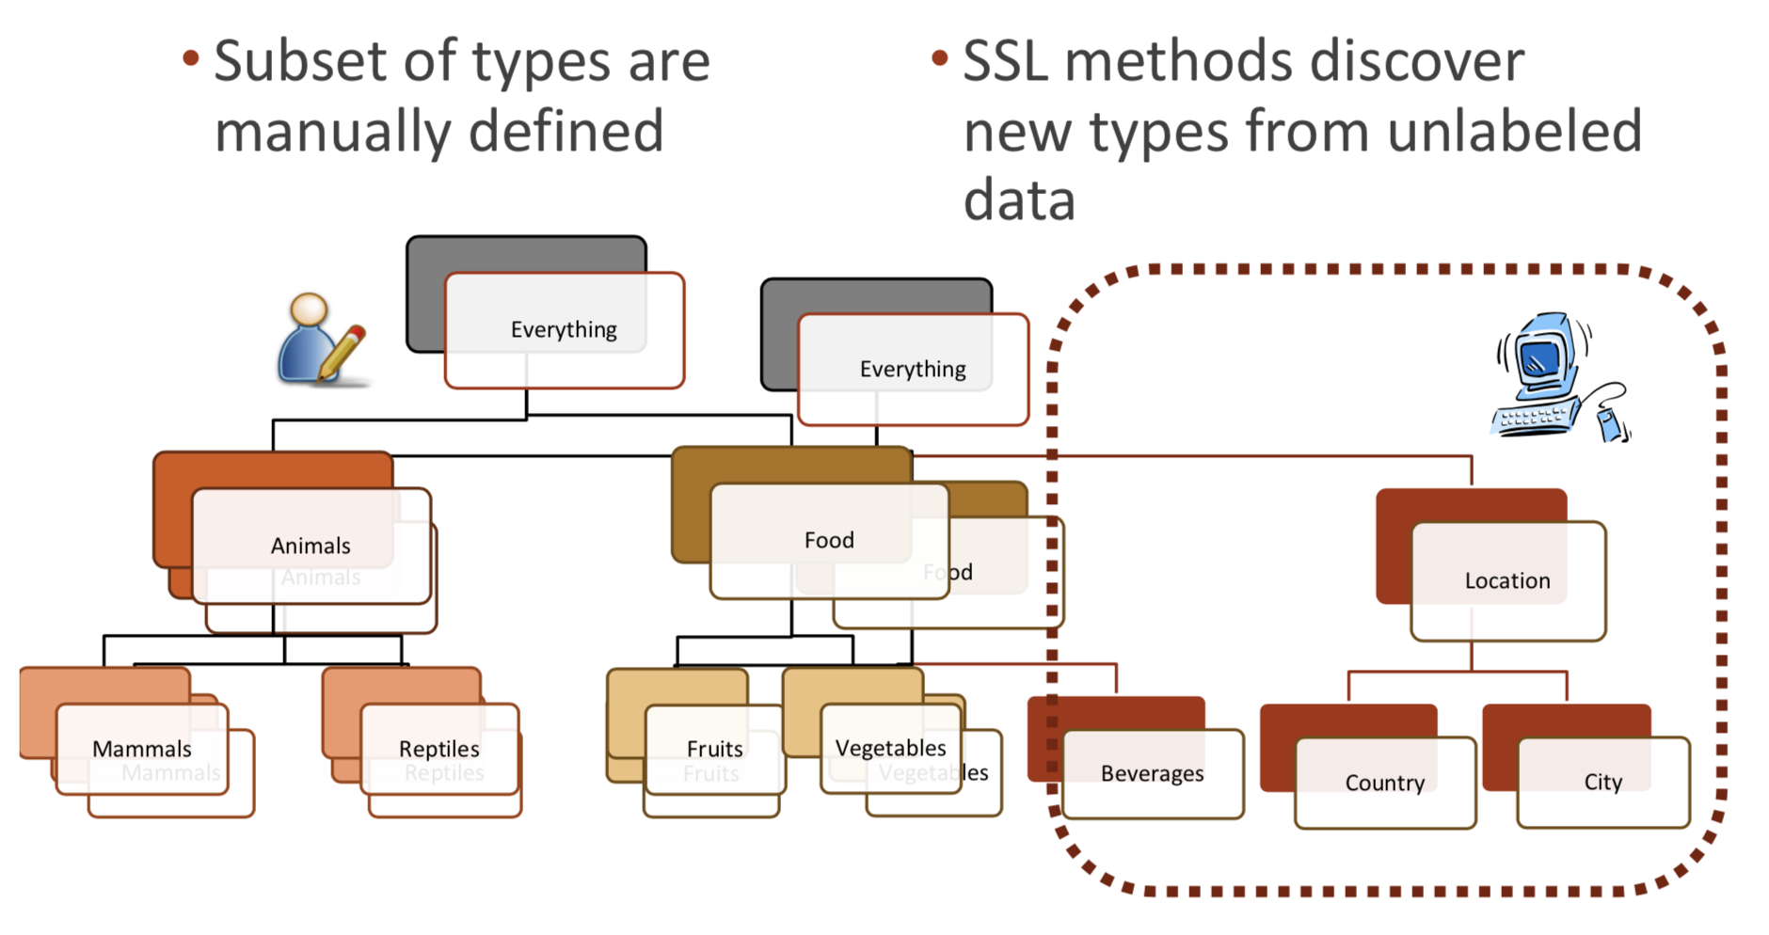
Defining Domain: Semi-automatic
Notes:
SSL: semi-supervised learning

Slide 39
Defining Domain: Automatic
Any noun phrase is a candidate entity
Dog, cat, cow, reptile, mammal, apple, greens, mixed greens, lettuce, red leaf lettuce, romaine lettuce, iceberg lettuce...
Any verb phrase is a candidate relation
Eats, feasts on, grazes, consumes

Slide 40
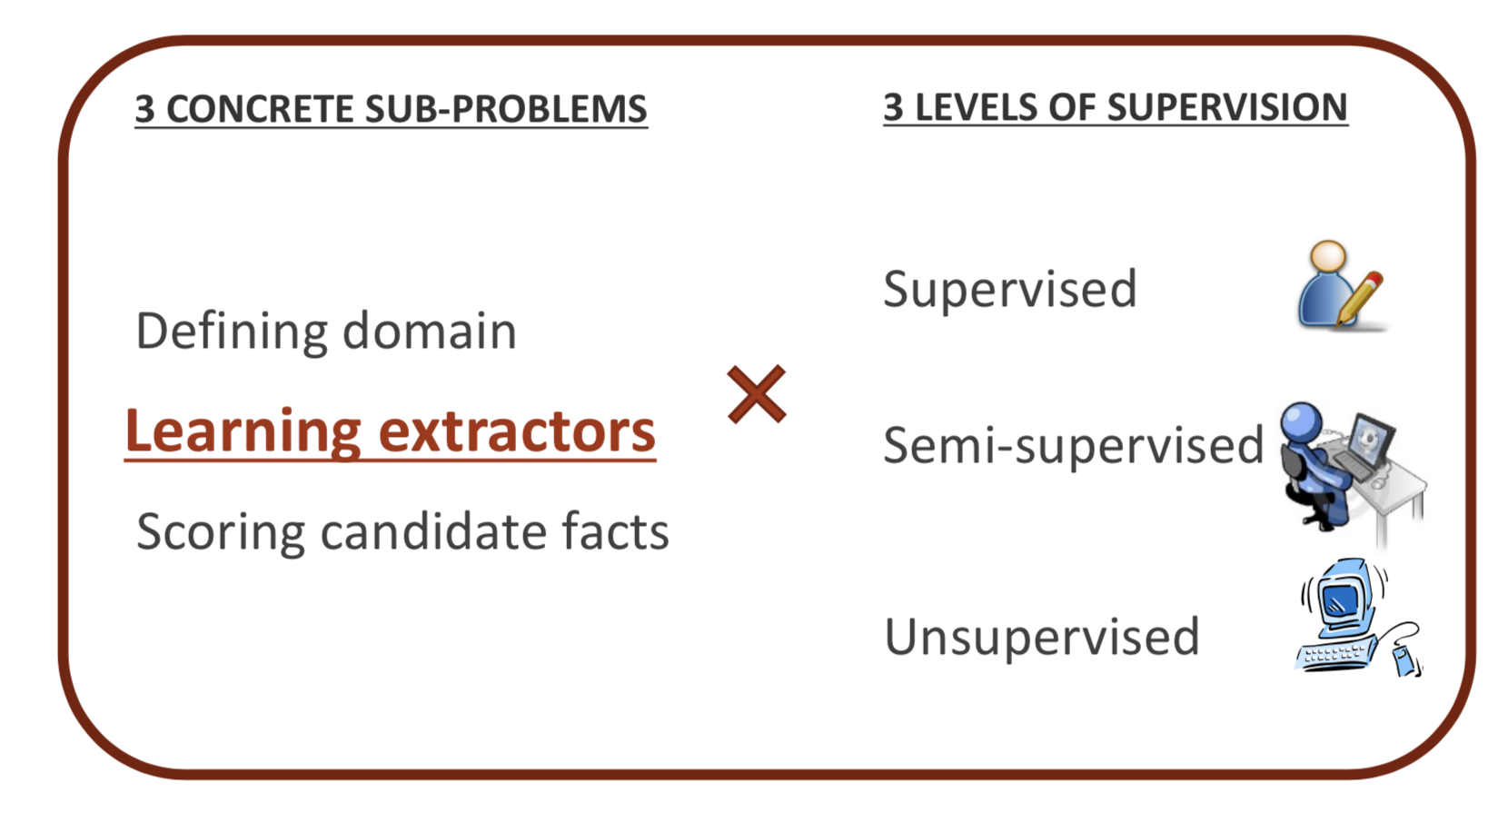
Learning Extractors

Slide 41
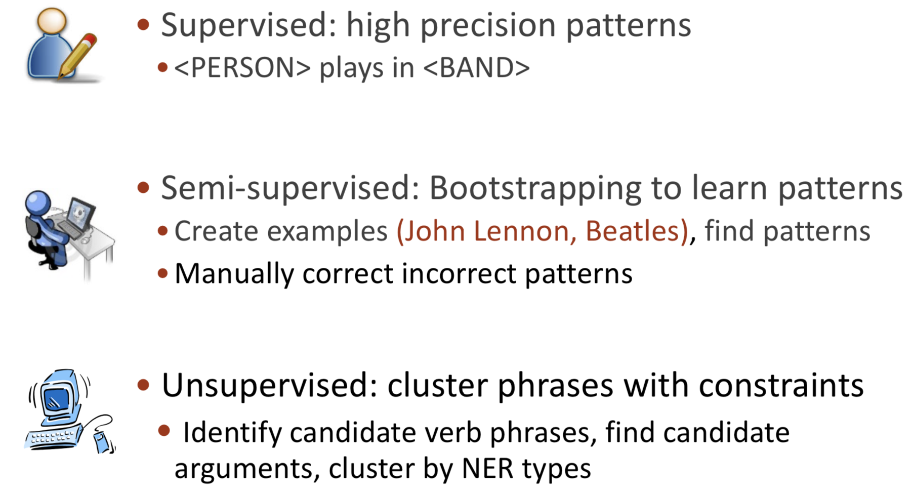
Learning Extractors
Notes:
NER: Named-entity recognition
命名實體識別
識別文本中具有特定意義的實體，主要包括人名、地名、機構名、專有名詞等，以及時間、數量、貨幣、比例數值等文字。
「歐巴馬是美國總統」的「歐巴馬」和「美國」都代表一個具體事物，因此都是命名實體。而「總統」不代表一個具體事物，因此不是命名實體。
Bootstrapping是通過在文本中匹配實體對和表達關係短語模式,尋找和發現新的潛在關係三元組

Slide 42
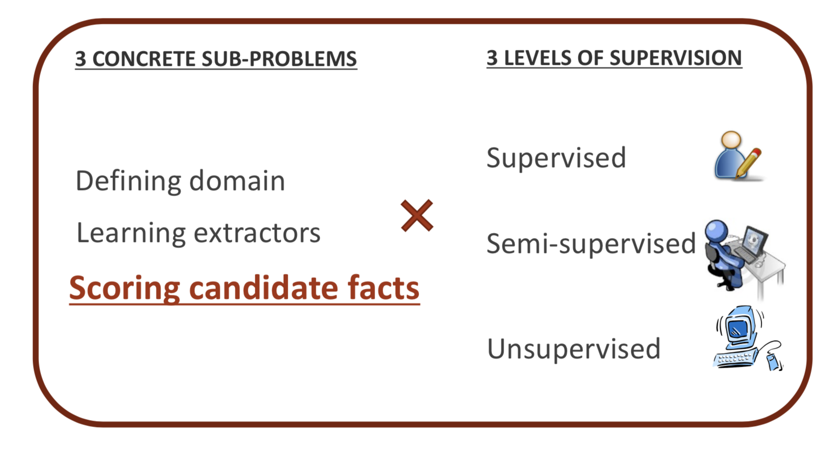
Scoring candidate

Slide 43
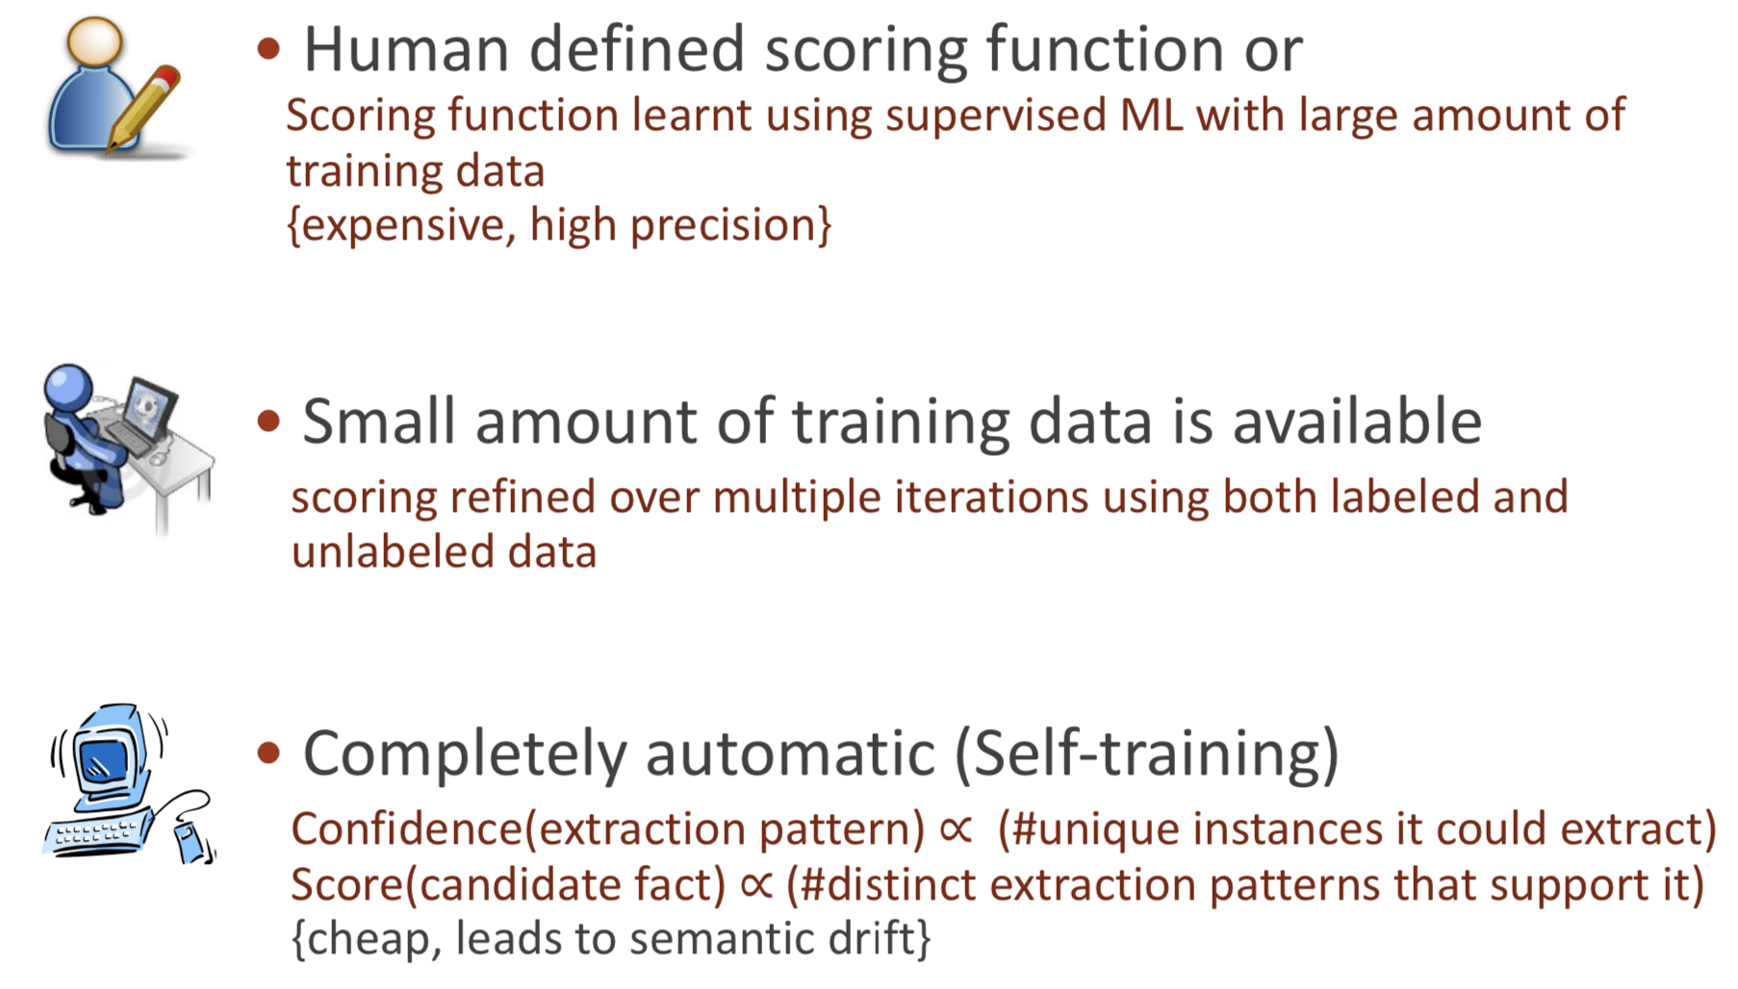
Scoring the candidate facts

Slide 44
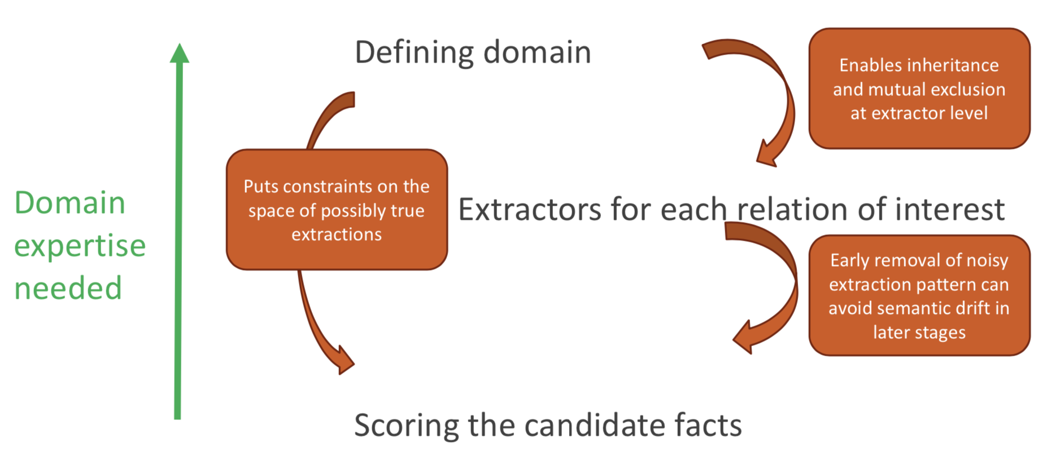
Impact of early supervision
Notes:
早期人力監督的影響性

Slide 45
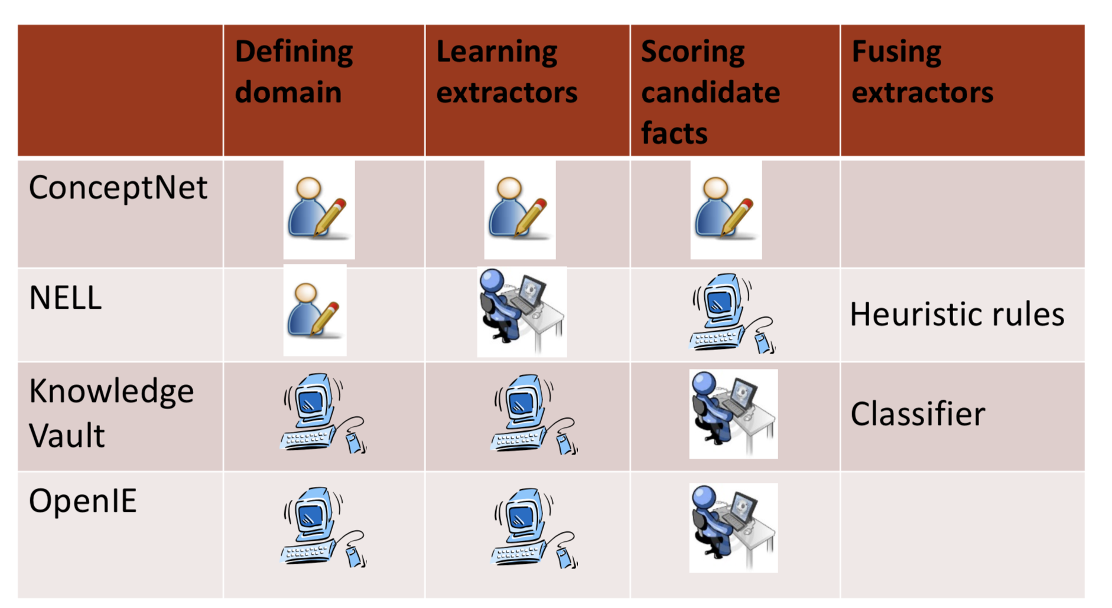
IE systems in practice
Notes:
Fusing extractor: 這種方式特別的地方
NELL -> 階層式架構
https://www.itread01.com/content/1547768544.html

Slide 46
Knowledge Extraction: Key Points
Built on the foundation of NLP techniques
Part-of-speech tagging, dependency parsing, named entity recognition, coreference resolution...
Challenging problems with very useful outputs
Information extraction techniques use NLP to:
define the domain
extract entities and relations
score candidate outputs
Trade-off between manual & automatic methods

Slide 47
The End

